Slide 1
Transport Layer
Protocols: UDP and TCP

Slide 2
Announcement: QUIZ 1
Quiz 1
Tuesday (1/29/2019)
Syllabus:
Introduction and Network Models
Application Layer Protocols

Slide 3

Figure Types of data deliveries

Slide 4

Figure Port numbers

Slide 5

Figure IP addresses versus port numbers

Slide 6

Figure Internet Assigned Number Authority (IANA) ranges

Slide 7

Figure Socket address

Slide 8

Figure Error control

Slide 9

Figure Position of UDP and TCP in TCP/IP suite

Slide 10
User Datagram
Protocol
(UDP)

Slide 11
USER DATAGRAM PROTOCOL (UDP)
The User Datagram Protocol (UDP) is called a connectionless, unreliable transport protocol. It does not add anything to the services of IP except to provide process-to-process communication instead of host-to-host communication.

Slide 12
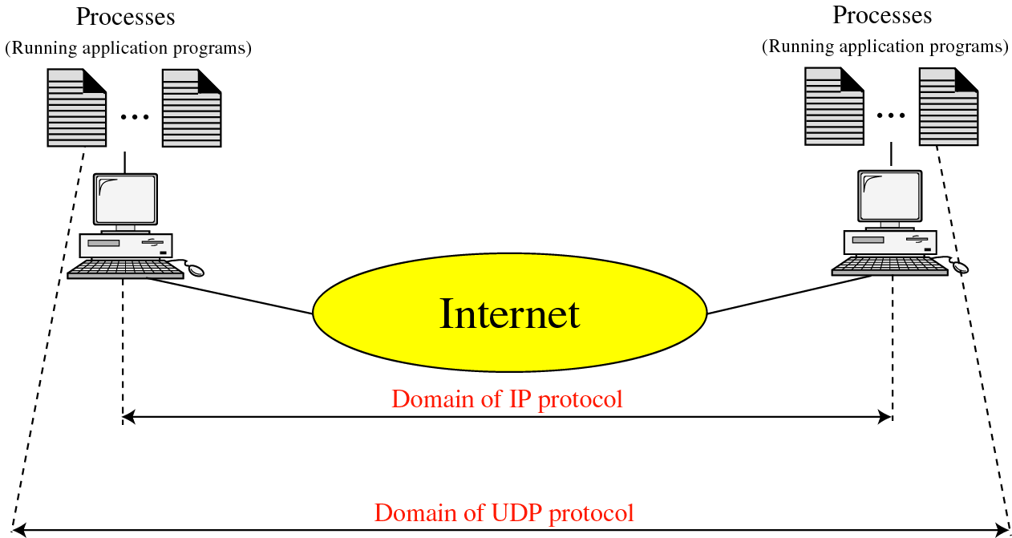

Slide 13
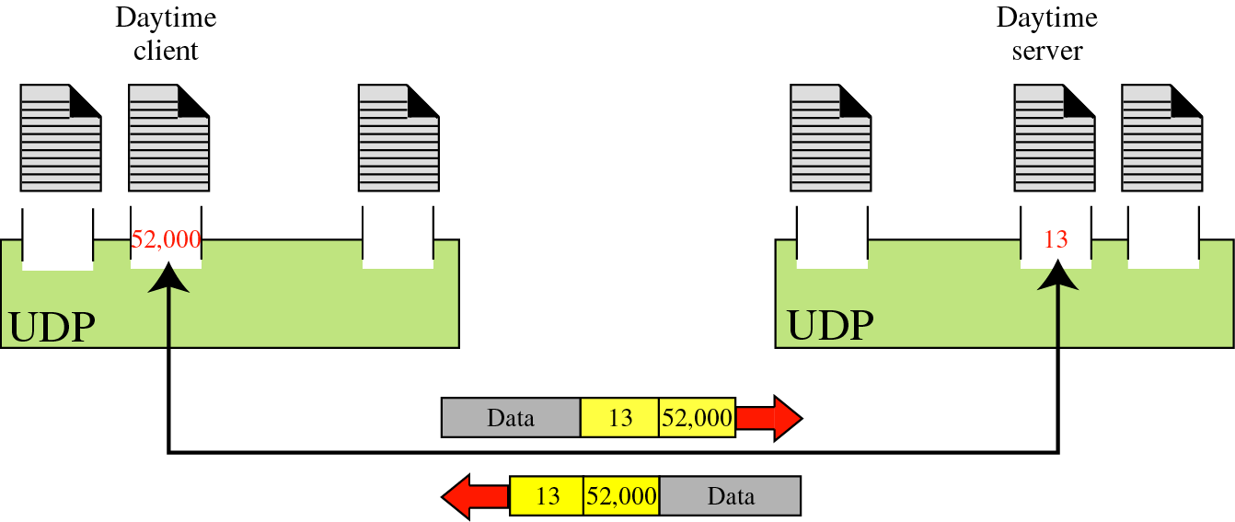

Slide 14

Figure User datagram format

Slide 15
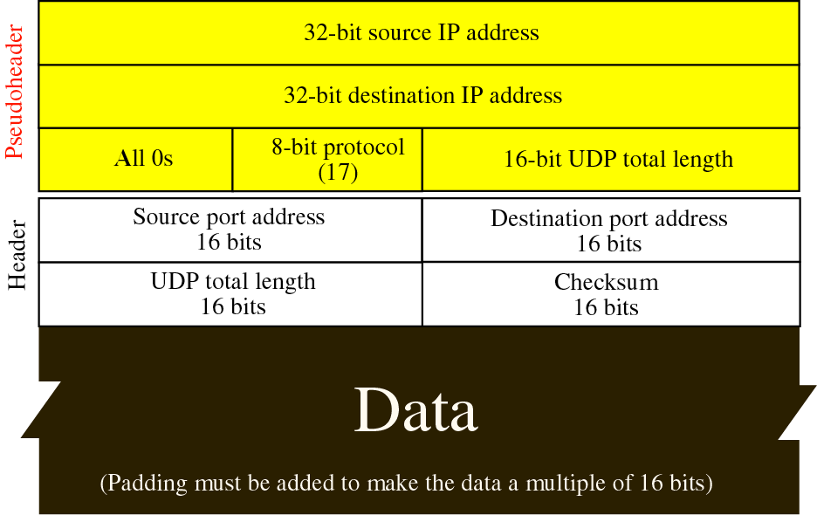

Slide 16
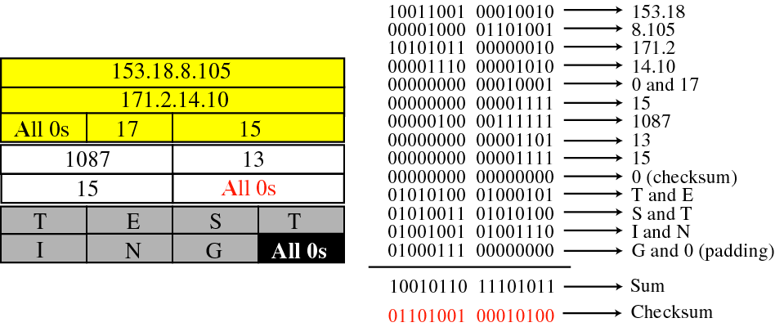

Slide 17
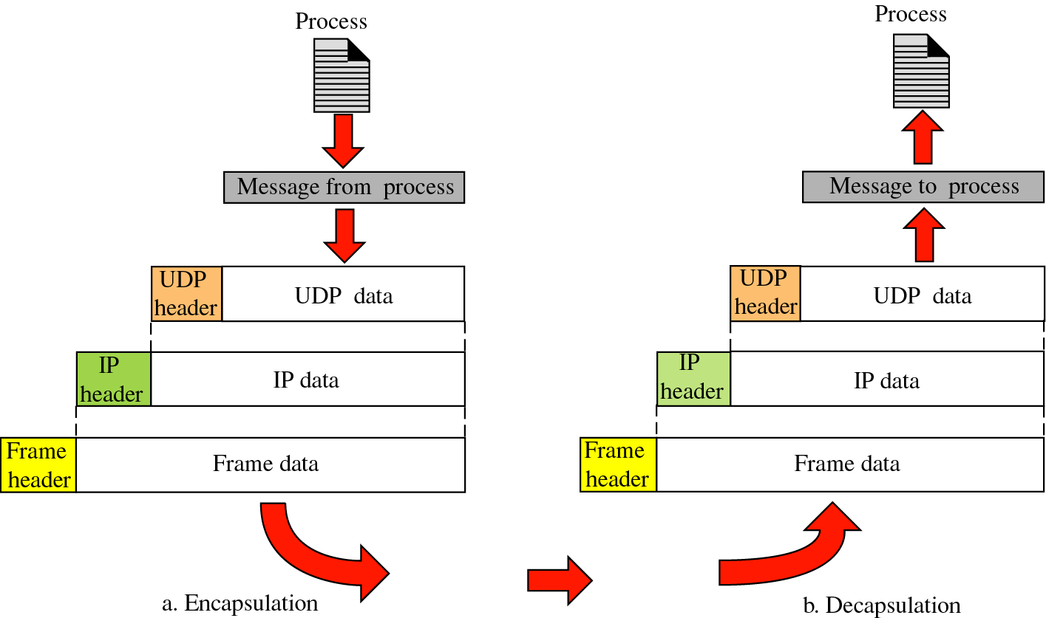

Slide 18
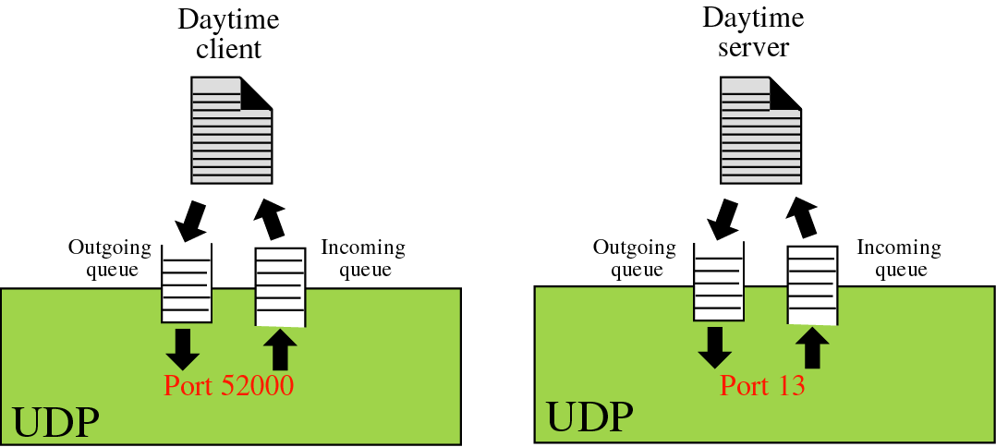

Slide 19


Table Well-known ports used with UDP

Slide 20

Example
In UNIX, the well-known ports are stored in a file called /etc/services. Each line in this file gives the name of the server and the well-known port number. We can use the
grep utility to extract the line corresponding to the desired application. The following shows the port for FTP. Note that FTP can use port 21 with either UDP or TCP.

Slide 21

Example
SNMP uses two port numbers (161 and 162), each for a different purpose, as we will see in Chapter 28.

Slide 22
Transmission
Control Protocol
(TCP)

Slide 23
TCP
TCP is a connection-oriented protocol; it creates a virtual connection between two TCPs to send data. In addition, TCP uses flow and error control mechanisms at the transport level.

Slide 24
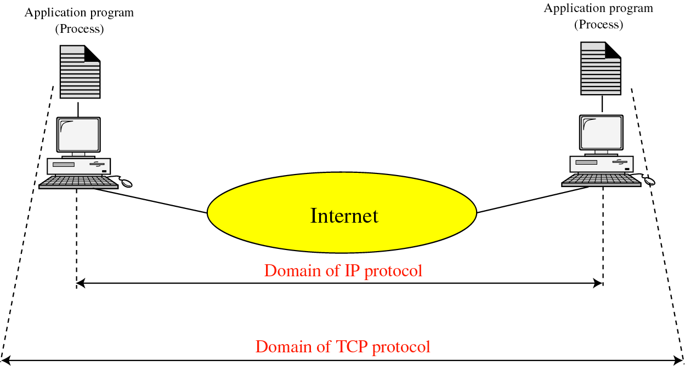

Slide 25
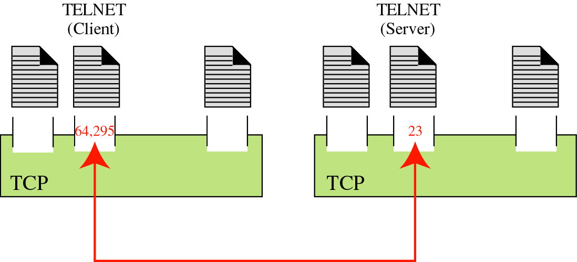

Slide 26

Table Well-known ports used by TCP

Slide 27

Figure Stream delivery

Slide 28

Figure Sending and receiving buffers

Slide 29

Figure TCP segments

Slide 30

Note
The bytes of data being transferred in each connection are numbered by TCP.
The numbering starts with a randomly generated number.

Slide 31
Note
The value in the sequence number field of a segment defines the
number of the first data byte
contained in that segment.

Slide 32

Example
TCP is transferring a file of 5000bytes. The first byte is numbered 10,001. What are the sequence numbers for each segment if data are sent in five segments, each carrying 1000bytes?
The following shows the sequence number for each segment:

Slide 33
Note
The value of the acknowledgment field in a segment defines
the number of the next byte a party expects to receive.
The acknowledgment number is cumulative.

Slide 34

Figure TCP segment format

Slide 35

Table Description of flags in the control field

Slide 36
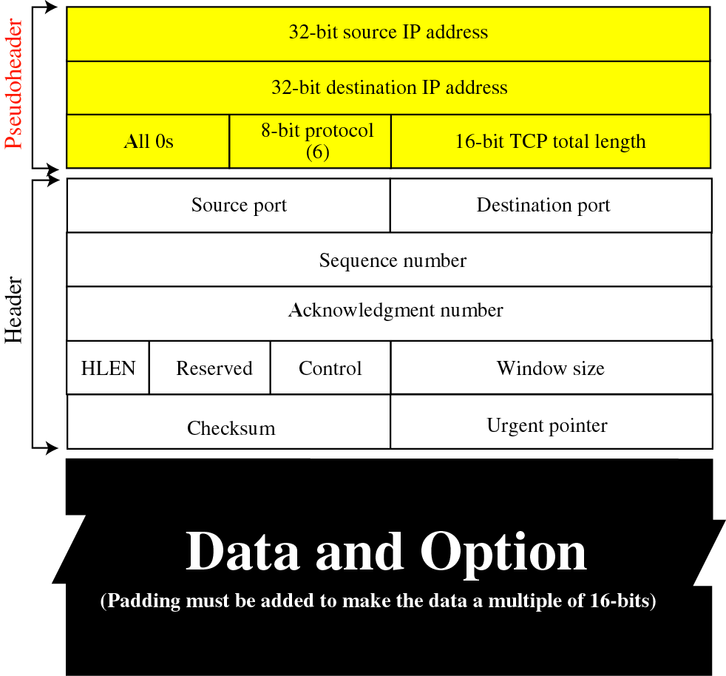

Slide 37

Figure Connection establishment using three-way handshaking

Slide 38
Note
A SYN segment cannot carry data, but it consumes one sequence number.

Slide 39
Note
A SYN + ACK segment cannot
carry data, but does consume one
sequence number.

Slide 40
Note
An ACK segment, if carrying no data, consumes no sequence number.

Slide 41

Figure Data transfer

Slide 42

Figure Connection termination using three-way handshaking

Slide 43
Note
The FIN segment consumes one sequence number if it does
not carry data.

Slide 44
Note
The FIN + ACK segment consumes
one sequence number if it
does not carry data.

Slide 45

Figure Half-close

Slide 46

Figure Sliding window

Slide 47
Note
A sliding window is used to make transmission more efficient as well as
to control the flow of data so that the destination does not become
overwhelmed with data.
TCP sliding windows are byte-oriented.

Slide 48
Example
What is the value of the receiver window (rwnd) for host A if the receiver, host B, has a buffer size of 5000 bytes and 1000 bytes of received and unprocessed data?
Solution
The value of rwnd = 5000 − 1000 = 4000. Host B can receive only 4000 bytes of data before overflowing its buffer. Host B advertises this value in its next segment to A.

Slide 49
Example
What is the size of the window for host A if the value of rwnd is 3000 bytes and the value of cwnd is 3500 bytes?
Solution
The size of the window is the smaller of rwnd and cwnd, which is 3000 bytes.

Slide 50
Example X
Figure 23.23 shows an unrealistic example of a sliding window. The sender has sent bytes up to 202. We assume that cwnd is 20 (in reality this value is thousands of bytes). The receiver has sent an acknowledgment number of 200 with an rwnd of 9 bytes (in reality this value is thousands of bytes). The size of the sender window is the minimum of rwnd and cwnd, or 9 bytes. Bytes 200 to 202 are sent, but not acknowledged. Bytes 203 to 208 can be sent without worrying about acknowledgment. Bytes 209 and above cannot be sent.

Slide 51

Figure Example Sliding Window

Slide 52
Note
ACK segments do not consume sequence numbers and are not acknowledged.

Slide 53
Note
In modern implementations (New Reno), a retransmission occurs if the retransmission timer expires or three duplicate ACK segments have arrived.

Slide 54
Note
No retransmission timer is set for an ACK segment.

Slide 55
Note
Data may arrive out of order and be temporarily stored by the receiving TCP,
but TCP guarantees that no out-of-order segment is delivered to the process.

Slide 56

Figure Normal operation

Slide 57

Figure Lost segment

Slide 58
Note
The receiver TCP delivers only ordered data to the process.

Slide 59

Figure Fast retransmission

